Slide 1


INTERNSHIP PROJECT
Submitted by:
K EEKSHITHA
21B01A5450

Slide 2


LEARNING OBJECTIVES
Module1: INTRODUCTION
Module2:PYTHON BASICS
Module3: JUPYTER NOTEBOOK, GOOGLE COLAB
Module4: PANDAS
Module5: NUMPY
Module6:MATPLOTLIB
Module7:SCIKIT LEARN
Module8:MINI PROJECT
Module9:MAIN PROJECT
Module10:FINAL EXAM

Slide 3
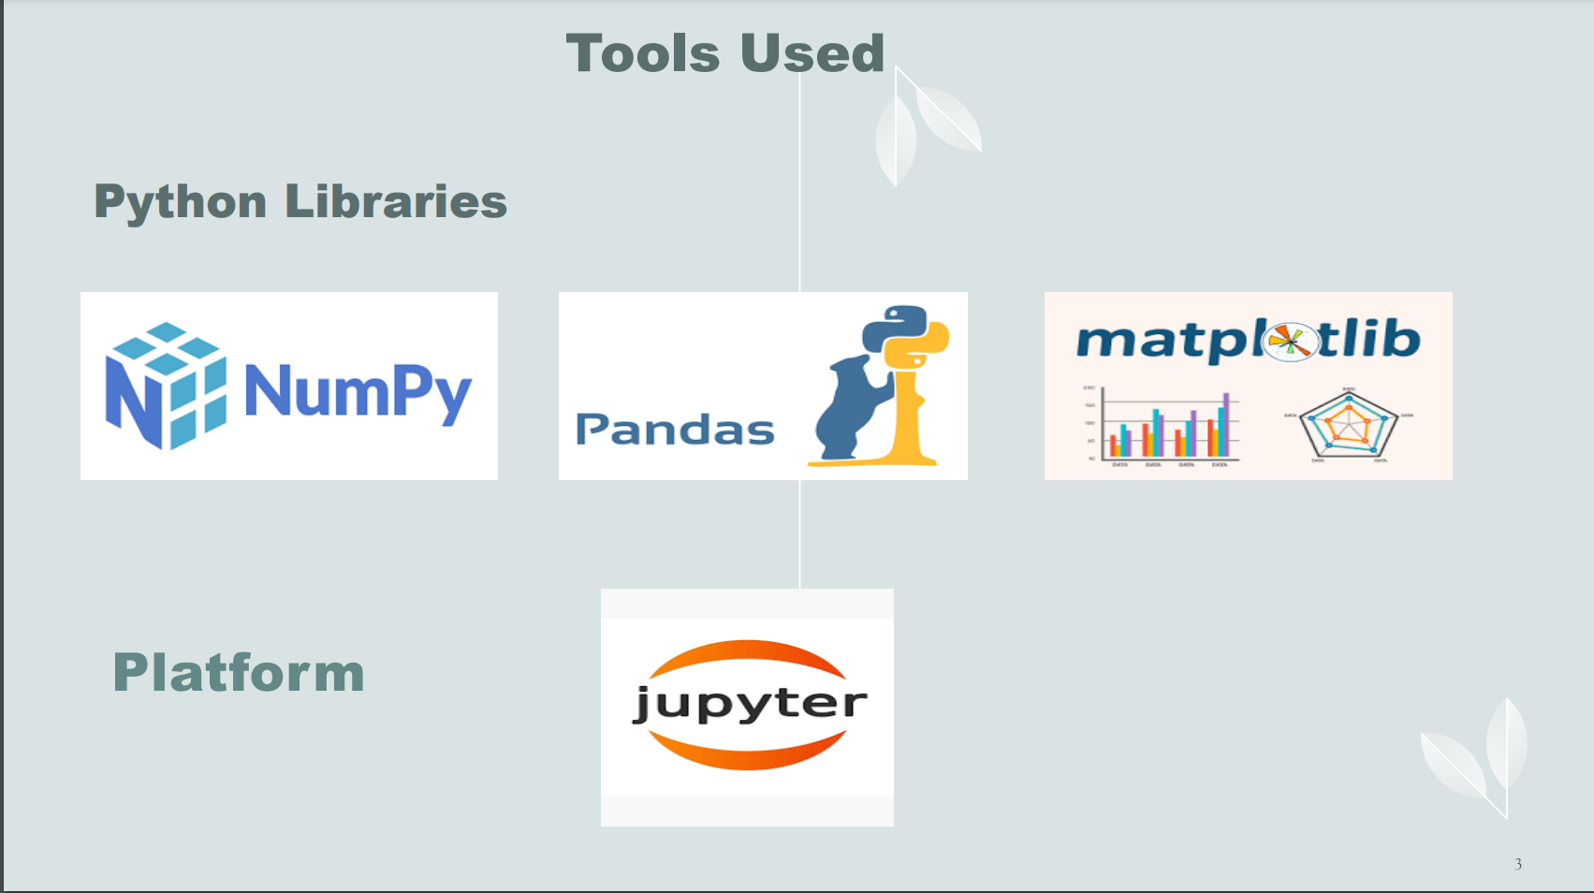

Slide 4
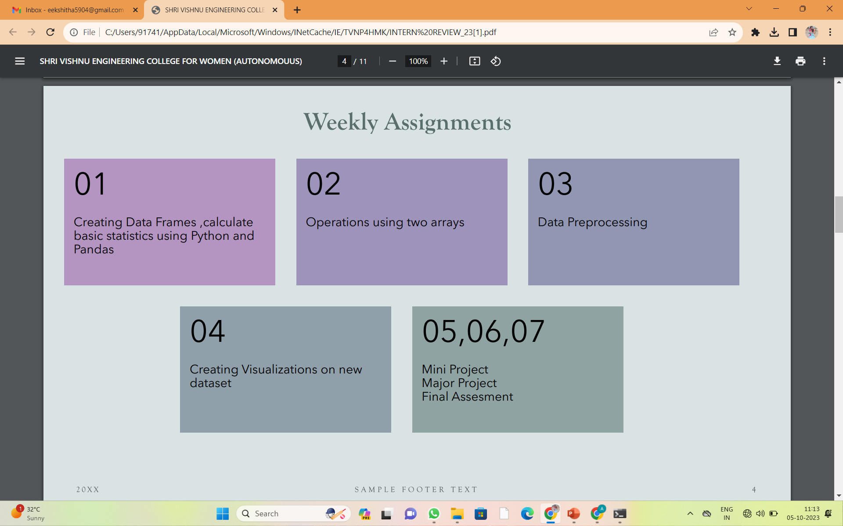

Slide 5
MINOR PROJECT
IRIS CLASSIFICATION:
An Iris classification machine learning project focuses on using a dataset of iris flower measurements to develop a model that can accurately classify iris flowers into specific species, such as setosa, versicolor, and virginica. This project typically employs supervised learning algorithms to train the model, making it a common introductory example for learning classification in machine learning.
ALGORITHM : K-Nearest Neighbour.

Slide 6
MAJOR PROJECT
CUSTOMER SEGMENTATION
A customer segmentation machine learning project involves using algorithms and data analysis to categorize a company's customer base into distinct groups based on shared characteristics and behaviors. This enables businesses to tailor marketing strategies and product offerings to each segment, ultimately improving customer satisfaction and increasing profitability.
ALGORITHMS USED : K-means Clustering,Hierarchical Clustering

Slide 7
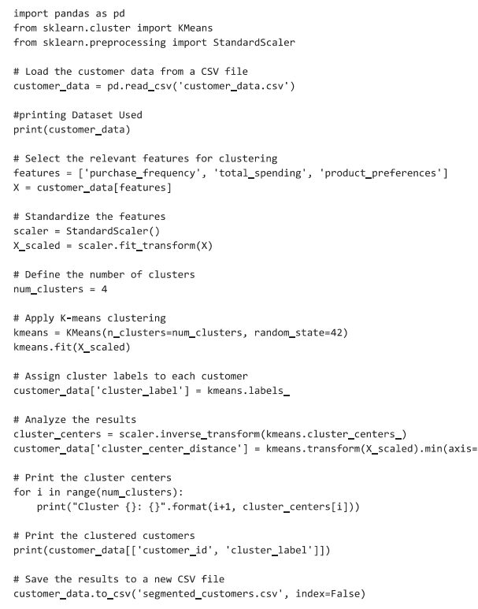
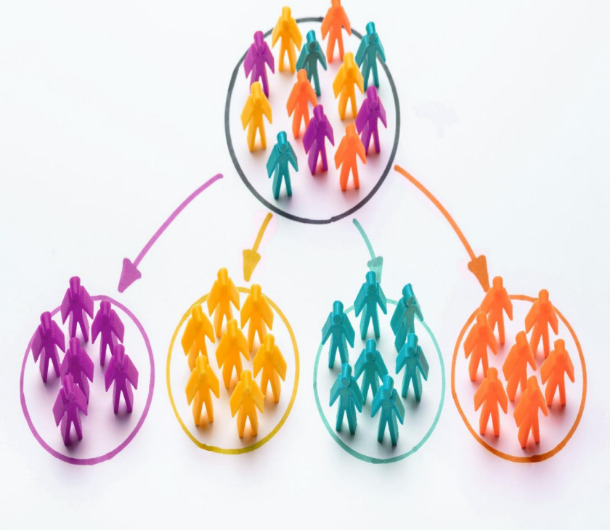
CODE

Slide 8
Internship works Folder Drive Link
https://drive.google.com/drive/folders/1HKPllbxdPJUwpOlQQrBvZuItYeSQfDDW?usp=sharing

Slide 9
THANK YOU

